Slide 1

Alexandru Ioan Cuza University of Iaşi
Faculty of Computer Science
DISSERTATION
A Model for Heart Sounds
Segmentation and Classification
using Neural Networks
Student: Oriana-Maria Oniciuc
Scientific Coordinator: Conf. Dr. Liviu Ciortuz
July 2018
Notes:
Buna ziua!
Ma numesc Oniciuc Oriana-Maria si va voi prezenta astazi A model for heart sounds segmentation and classification using neural networks sub coordonarea domnului Conf. dr. Liviu Ciortuz.
In proiectul nostru am antrenat 2 clasificatori care separa inregistrari de batai de inimi in sanatoase si bolnave (cu murmur sau extrasistole).

Slide 2
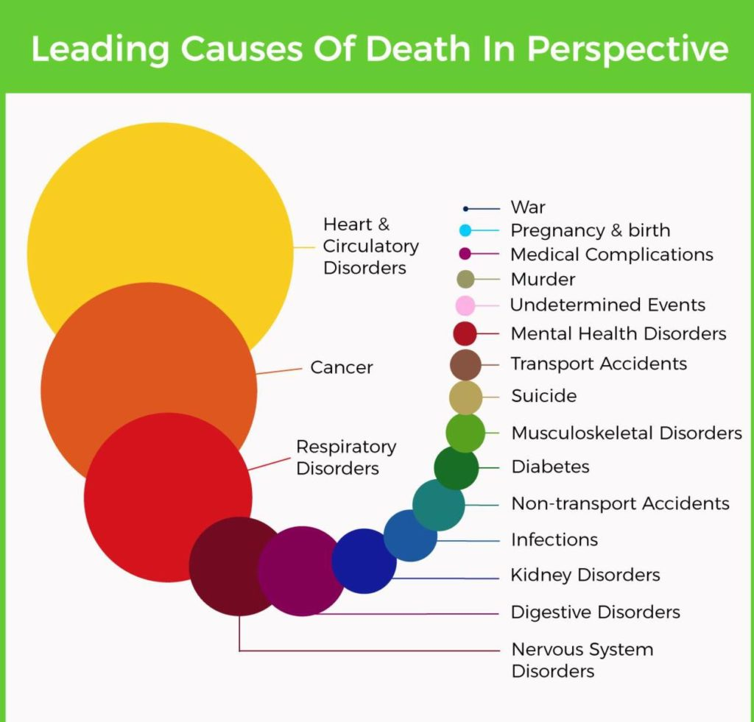
Source:http://www.who.int/news-room/fact-sheets/detail/the-top-10-causes-of-death
Notes:
Cauza principala de deces in lume e reprezentata de bolile cardiovasculare, deci studiile in acest domeniu au un impact major in viata de zi cu zi.

Slide 3
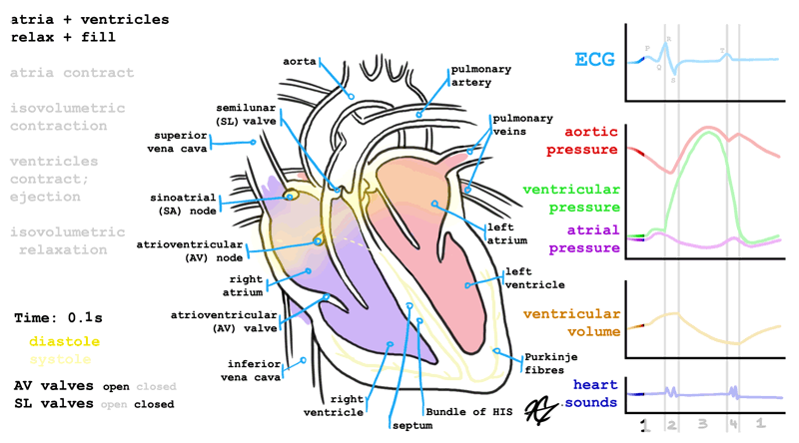
Source:https://gifer.com/en/2mFO
‹#›
A Model for Heart Sounds Segmentation and Classification using Neural Networks - Introduction
Notes:
Inima, e organul principal al sistemului circulator. Sunt numeroase masuratorile pe care le putem face asupra acesteia pentru a detecta posibile boli, iar noi vom analiza phonocardiogramele (adica inregistrari asupra sunetelor pe care inima le produce). Putem observa in dreapta jos ca cele 2 sunete principale se produc la inchiderea valvelor dintre atrii si ventricule. Prin ascultarea inimii putem sa identificam murmurul sau prezenta extra sistolelor.
‹#›

Slide 4
Problem description
Predict with a high rate of trust if a person has arrhythmia or murmurs through a phonocardiogram.
Data specifications
The .wav 585 recordings have the following properties:
      varying lengths, between 1 and 30 seconds
      44100 Hz and 4000 Hz samplerate
      3 classes: normal, murmur, extrasystole
‹#›
A Model for Heart Sounds Segmentation and Classification using Neural Networks - Methodology and research methods
Notes:
Ce ne dorim sa obtinem e un clasificator care sa ne prezica cu o rata cat mai mare daca o persoana prezinta murmur sau extrasistole utilizand doar PCG.
Datele pe care le-am folosit au fost prezentate in 2012 intr-un challenge si reprezinta 585 de inregistrari wav. Inregistrarile au fost preluate in 2 dataseturi diferite, in datasetul A prin inregistrari facute cu ajutorul unei aplicatii mobile iStethoscope, iar datasetul B a fost preluat dintr-un studiu clinic, inregistrarile fiind facute in spital. Toate fisierele au durate diferite, de la o sec pana la 30 de secunde. De asemenea si frecventele sunt diferite in cele 2 dataseturi: 44 100 Hz si 4 000 Hz; iar pentru aceasta am adus toate inregistrarile la o frecventa medie, de 16 000 Hz. Datele sunt impartite in 3 clase: normal, cu murmur sau cu extrasistole.

Slide 5
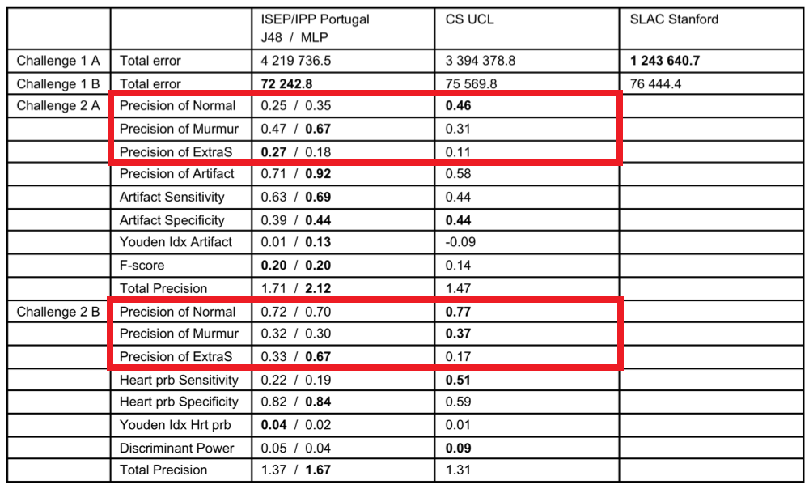
State of the art - PASCAL Classifying Heart Sounds Challenge (2012)
‹#›
A Model for Heart Sounds Segmentation and Classification using Neural Networks – Introduction
Notes:
Rezultatele obtinute de cele mai bune 3 echipe in cadrul challengului sunt prezentate in acest tabel. Rezultatele cu care ne vom compara sunt cele subliniate.

Slide 6
State of the art - Other research
Singh, Mandeep & Cheema, Amandeep. (2013). Heart Sounds Classification using Feature Extraction of Phonocardiography Signal. International Journal of Computer Applications.
  Accuracy of Normal - 93.33%
  Accuracy of Murmur - 93.33%
Randhawa, Simarjot & Singh, Mandeep. (2015). Classification of Heart Sound Signals Using Multi-modal Features. Procedia Computer Science.
  Accuracy - 99.6% / 98.8% / 93.3%
Zhang, Wenjie & Han, Jiqing & Deng, Shi-wen. (2017). Heart sound classification based on scaled spectrogram and partial least squares regression. Biomedical Signal Processing and Control.
  Precision of Normal (A) - 0.67 / 0.6
  Precision of Murmur (A) - 0.91 / 0.91
  Precision of Extra Heart Sound (A) - 0.37 / 0.44
  Precision of Normal (B) - 0.74 / 0.76
  Precision of Murmur (B) - 0.66 / 0.65
  Precision of Extrasystole (B) - 0.24 / 0.33
‹#›
A Model for Heart Sounds Segmentation and Classification using Neural Networks - Introduction
Notes:
Dupa 2012, alte rezultate obtinute sunt cele prezentate aici. Masurile prezentate de primele 2 articole sunt putin diferite fata de cele evaluate in cadrul challengeului.

Slide 7
Data processing
Peak analysis
Normalization
Sliding window for data selection
Feature extraction
‹#›
A Model for Heart Sounds Segmentation and Classification using
Neural Networks - Methodology and research methods - Data processing
Notes:
In continuare va voi prezenta pasii pe care i-am facut in procesarea inregistrarilor pentru inputul clasificatorilor.

Slide 8
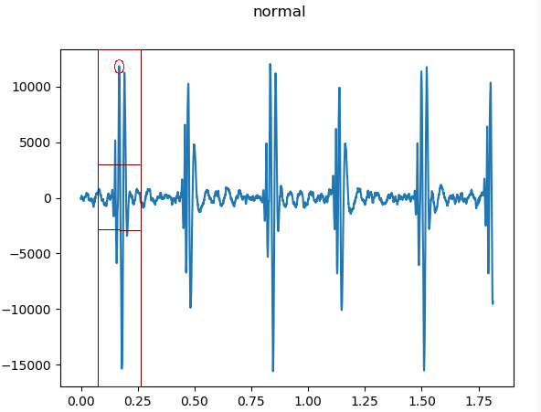
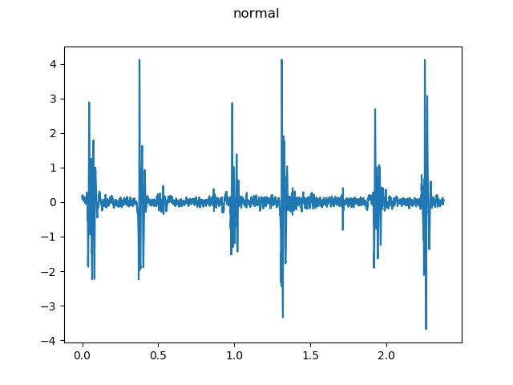
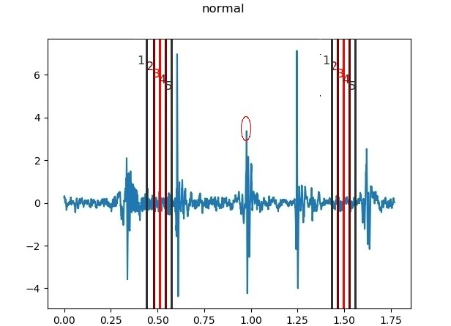
‹#›
A Model for Heart Sounds Segmentation and Classification using
Neural Networks - Methodology and research methods - Data processing
Notes:
Aflarea pozitiei in timp a fiecarei batai a inimii am facut-o utilizand un algoritm de peak detection. Am luat un interval de 0.2 secunde in care am considerat ca pozitia unei batai a inimii va fi reprezentata de maximul din acest interval. Dar daca am muta sectiunea de 0.2 secunde intre 2 batai succesive atunci am putea interpreta ca bataie de inima un maxim gresit. De aceea am adaugat inca o conditie si anume ca pentru a salva ca bataie de inima un peak, amplitudinea acestuia trebuie sa depaseasca valoarea de 2.8 * stdev(rec).
A doua etapa a procesarii a reprezentat normalizarea datelor. Am calculat normal L2 pentru fiecare inregristrare si am impartit toate valorile la aceasta. Astfel am obtinut zona de noise in intervalul [-1, 1].
Pentru a avea un input uniform pentru modelel noastre, am ales sa taiem din fiecare inregistrare ferestre de cate o secunda centrate in peakurile detectate anterior.

Slide 9
Classification Models
Multi-Class Convolutional Neural Network
Multi-Task Learning
‹#›
A Model for Heart Sounds Segmentation and Classification using
Neural Networks - Methodology and research methods - Classification models

Slide 10
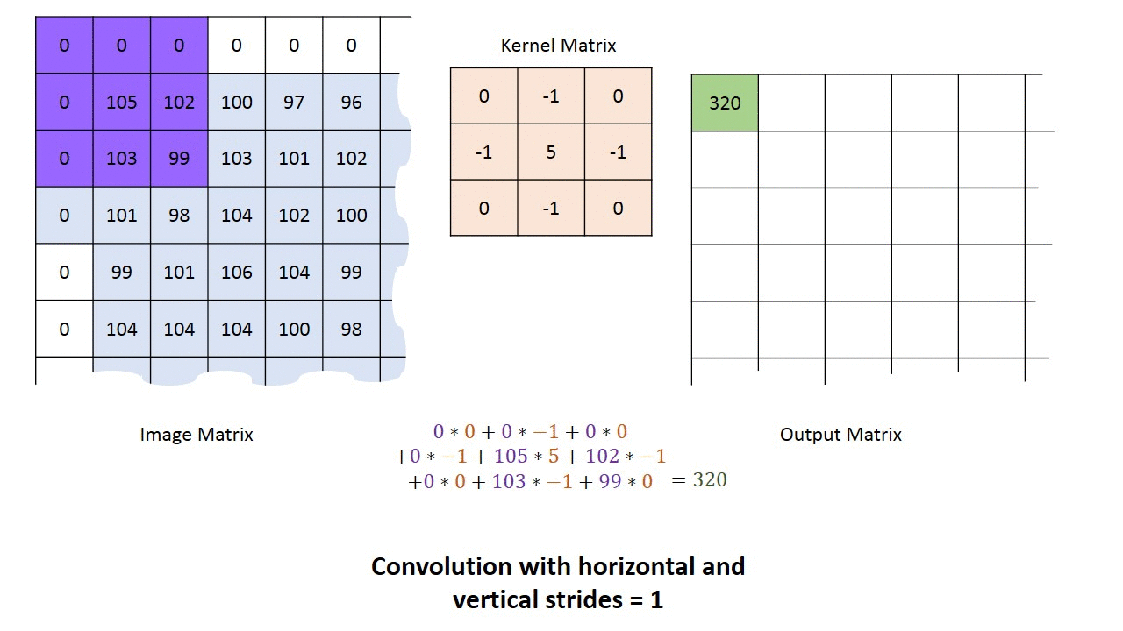
Convolutional Neural Network
Source:http://machinelearninguru.com/_images/topics/computer_vision/basics/convolutional_layer_1/stride1.gif
‹#›
A Model for Heart Sounds Segmentation and Classification using
Neural Networks - Methodology and research methods - Classification models

Slide 11
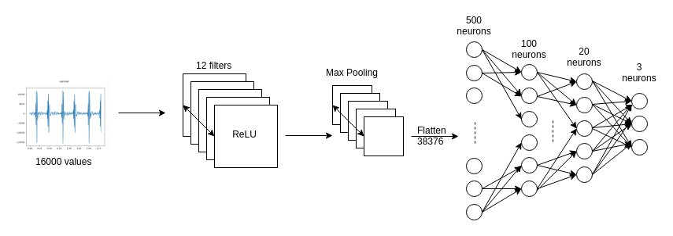
Multi-Class CNN
‹#›
A Model for Heart Sounds Segmentation and Classification using
Neural Networks - Methodology and research methods - Classification models

Slide 12
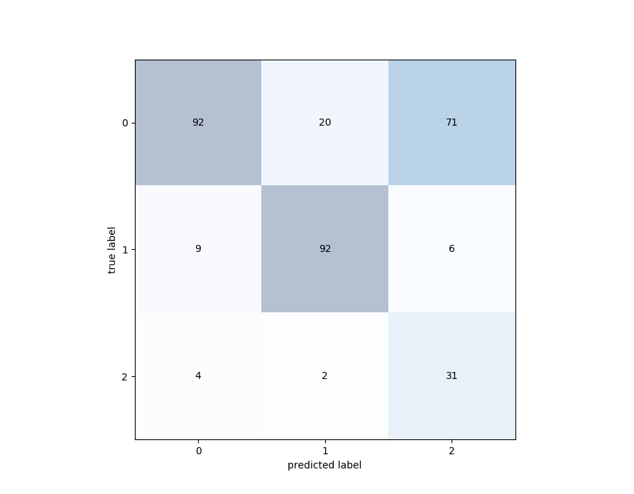
Results - Multi-class CNN
Test accuracy: 65.74%
‹#›
A Model for Heart Sounds Segmentation and Classification using Neural Networks - Results

Slide 13
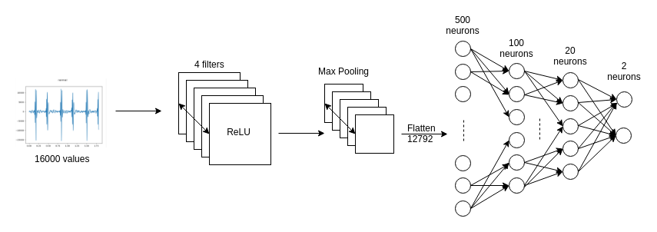
CNN Normal heartbeat
‹#›
A Model for Heart Sounds Segmentation and Classification using
Neural Networks - Methodology and research methods - Classification models

Slide 14
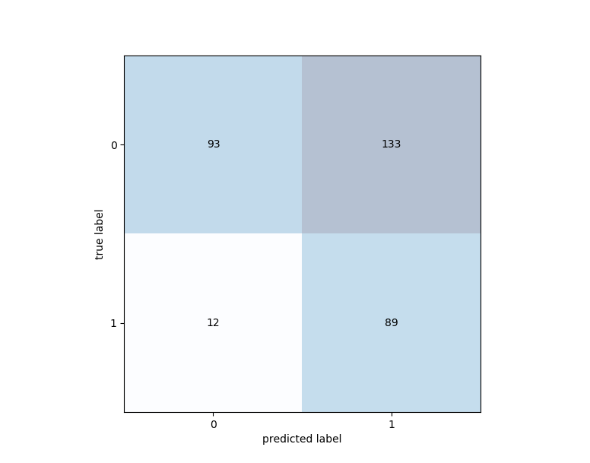
Results - CNN Normal heartbeat
Test accuracy: 55.65%
‹#›
A Model for Heart Sounds Segmentation and Classification using Neural Networks - Results

Slide 15
CNN Murmur heartbeat
‹#›
A Model for Heart Sounds Segmentation and Classification using
Neural Networks - Methodology and research methods - Classification models

Slide 16
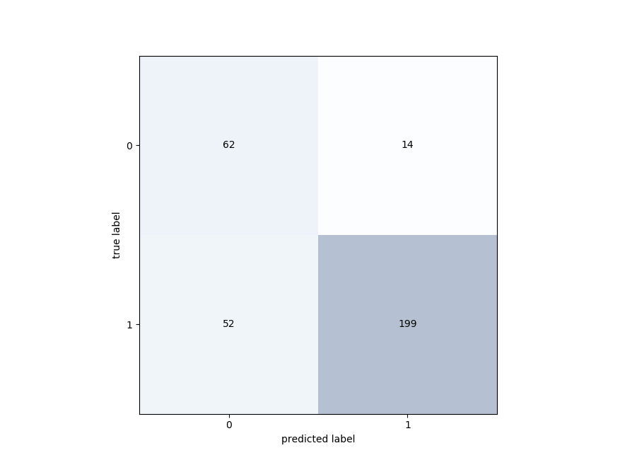
Results - CNN Murmur heartbeat
Test accuracy: 79.81%
‹#›
A Model for Heart Sounds Segmentation and Classification using Neural Networks - Results

Slide 17
Feature extraction
Mean Peak Frequency and Amplitude
Peak Frequency and Amplitude Standard Deviation
Minimum and Maximum Peak Distance
Minimum and Maximum Peak Amplitude
Mean Amplitude
Standard Deviation Amplitude
Number of Peaks
Other approaches are presented in [3-4].
A Model for Heart Sounds Segmentation and Classification using
Neural Networks - Methodology and research methods - Data processing
‹#›
Notes:
AdaBoost -> pt ca date imbalansate

Slide 18
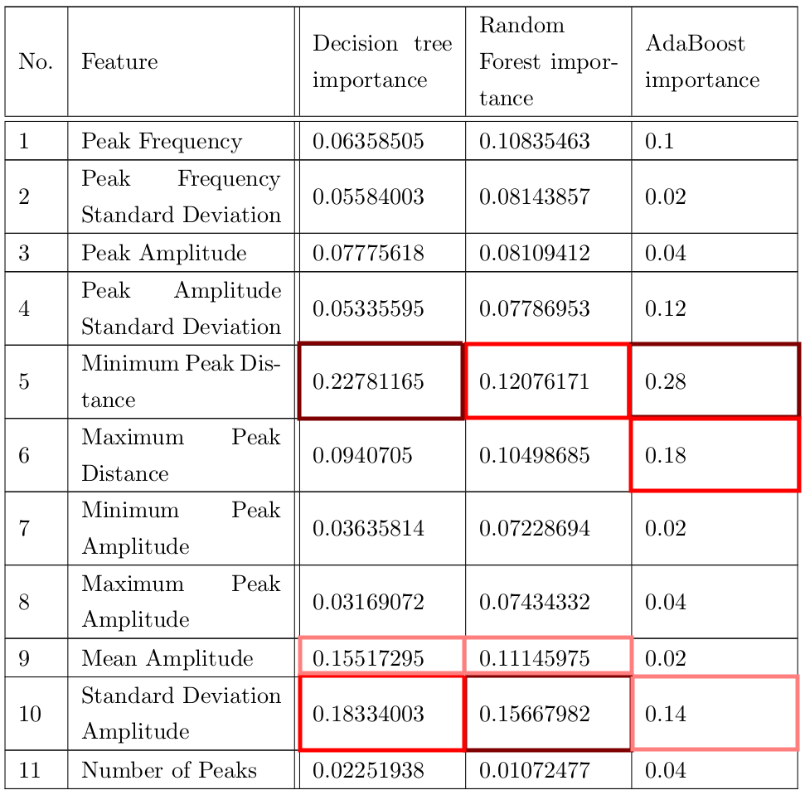
Feature extraction
‹#›
A Model for Heart Sounds Segmentation and Classification using
Neural Networks - Methodology and research methods - Data processing

Slide 19
Results - Extrastole heartbeat Models
Test accuracy (using all features):
53.94% / 58.67% / 70.03%
Test accuracy (using top features):
55.2% / 57.72% / 65.61%
‹#›
A Model for Heart Sounds Segmentation and Classification using Neural Networks - Results

Slide 20
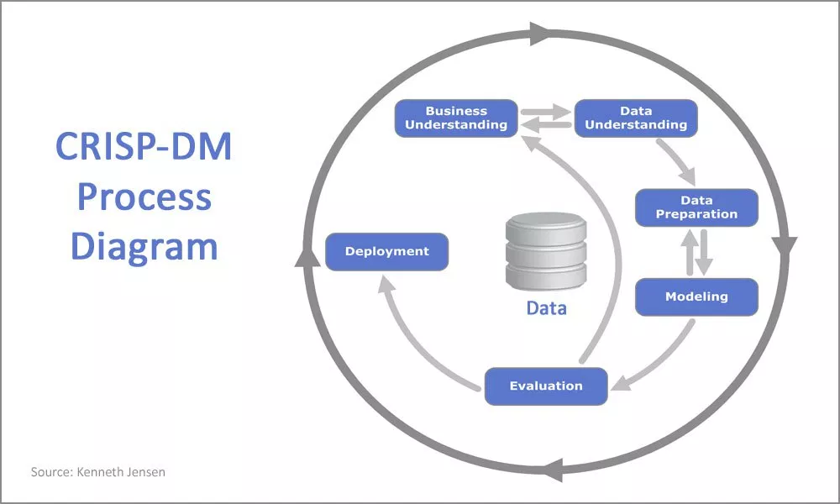
‹#›
A Model for Heart Sounds Segmentation and Classification using Neural Networks - Methodology and research methods

Slide 21




Technologies
‹#›
A Model for Heart Sounds Segmentation and Classification using Neural Networks - Technologies

Slide 22
Bibliography
The PASCAL Classifying Heart Sounds Challenge 2011, Bentley P. and Nordehn G. and Coimbra M. and Mannor S. Available: http://www.peterjbentley.com/heartchallenge/index.html
Singh, Mandeep, Cheema, Amandeep. (2013). Heart Sounds Classification using Feature Extraction of Phonocardiography Signal. International Journal of Computer Applications.
M Debbal, S, bereksi reguig, Fethi. (2008). Frequency analysis of the heartbeat sounds. IJBSCHS.
Philip de Chazal, M. O'Dwyer and R. B. Reilly, "Automatic classification of heartbeats using ECG morphology and heartbeat interval features," in IEEE Transactions on Biomedical Engineering, 2004.
Randhawa, Simarjot & Singh, Mandeep. (2015). Classification of Heart Sound Signals Using Multi-modal Features. Procedia Computer Science.
Zhang, Wenjie & Han, Jiqing & Deng, Shi-wen. (2017). Heart sound classification based on scaled spectrogram and partial least squares regression. Biomedical Signal Processing and Control.
‹#›
A Model for Heart Sounds Segmentation and Classification using Neural Networks

